Slide 1

Stepper Motors
Philip Hills
Senior Electrical Engineer

Slide 2
Types of DC Motors
Brushed DC motor
  Continuous rotation
  Mechanical commutation (brushes)
Brushless DC (BLDC) motor
  Continuous rotation
  Electronic commutation
Stepper motor
  Discrete steps (small fraction of one rotation)
  No commutation
  Allows for open loop control
    Can be moved a definite distance
    Can eliminate position sensor

Slide 3
Types of Stepper Motors
Permanent Magnet
  Permanently magnetized rotor
Variable Reluctance
  Ferromagnetic (not magnetized) rotor
  Usually employs toothed rotor for smaller step size
Hybrid
  Permanently magnetized rotor
  Employs toothed rotor for smaller step size
  Moderate Torque
  Large Step Size
  Low Torque
  Moderate Step Size
  No Detent Torque
  High Torque
  Small Step Size

Slide 4
Simple Stepping Motor
Simplified (2 pole) stepper motor
Two fixed armatures
Two pole permanent magnet rotor
A
Two coil windings
B

Slide 5
Wave Stepping
Stepping sequence
(wave stepping)
Positive current:
No current:
Negative current:
Coil A
Coil B
+
-
+
A
A
A
A
A
B
+
B
B
-
B
B
Executing reverse sequence causes motor to turn in reverse direction
Applying initial power can cause motor to jump as much as two steps, depending on initial rotor position

Slide 6
Wave Stepping
A
B

Slide 7
Normal Full Stepping
Electric current distributed between both coils
Current per coil is lower for same torque
Overall current is higher for same torque
  Lower electrical efficiency
Positive current:
Negative current:
Coil A
Coil B
A
A
A
A
A
B
B
B
B
B

Slide 8
Full Stepping
A
B

Slide 9
Half Stepping
Allows rotor to be positioned halfway between full steps
Creates large torque ripple as rotor turns, unless current is adjusted each half-step
Coil A
Coil B
A
A
A
A
A
B
B
B
B
B
A
A
A
A
B
B
B
B

Slide 10
Half Stepping
A
B

Slide 11
Microstepping
Allows rotor to be positioned in almost any position between full steps
Requires capability to adjust current in each coil (not just on/off)
When power is turned off, rotor will turn to detent position
A
A
A
A
A
B
B
B
B
B
Relative Current:
A B
A B
A B
A B
A B
( Four microsteps per step )

Slide 12
Microstepping
A
B

Slide 13
Microstepping Waveform
Microstep waveform is sinusoidal (not linear)
  If using a linear DAC to generate waveform, an extra two or three bits of resolution are required to keep error below 1/10 of microstep
Coil A
Coil B
( Eight microsteps per step )
Mechanical tolerance of most motors can not position accurately beyond 64 microsteps
Some systems dynamically switch between microstepping (at slow speed) and full stepping (at high speed)
  If pulses are generated by software, reduces processor load at high speeds
  Can use normal full stepping to get more torque at high speeds

Slide 14
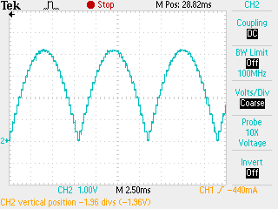
Microstepping Waveform
Real world example
(actual oscilloscope traces)
Smaller steps
Larger steps
( Sixteen microsteps per step )

Slide 15
Multiple Poles
Adding more poles to stator decreases step size (increases resolution)
  50 poles with 200 steps / revolution are common
Adding mores poles to rotor increases torque
Four steps per revolution
Eight steps per revolution
Adding more stator armatures/coils also decreases step size (increases resolution)
  Three and five coils (“phases”) are sometimes used

Slide 16
Maximum Current Rating
Maximum current in stepper motor is primarily limited by thermal considerations
  If motor gets too hot, damage results
    Insulation damaged, permanent magnets are demagnetized
Usually maximum motor current is given in “amps RMS” per coil
  RMS value gives equivalent power (heat dissipation)
  If microstepping, current waveform is sinusoidal
    For sine wave, peak current is (2)^{½} = 1.414 times RMS current
    A motor rated at 1A RMS, should be driven 1.4A peak current (sine)
    (should reduce to 1A when holding (not moving))
  If full stepping, each coil is always on (one polarity or the other)
    For DC current, peak current equals RMS current
    A motor rated at 1A RMS, should be driven 1A (DC)
  If wave stepping, current is 50% duty cycle square wave (on half the time)
    For 50% duty cycle square wave, peak current is (2)^{½} = 1.414 times RMS current
    A motor rated at 1A RMS, should be driven 1.4A peak current (square)
    (should reduce to 1A when holding)

Slide 17
Current Reduction
When motor is not moving, current to windings can be reduced
  Motor torque is highest when not moving (see torque-speed curve)
  No force required for acceleration
Current can usually be reduced considerably
  Holding current typically 20% - 50% of run current
Reduced current results in less power dissipation (less heat)
  Especially when motor has low duty cycle
Especially important when wave stepping, half stepping, or microstepping
  Avoid overheating coil when stopped at peak current
When reducing current under load, motor can move a fraction of a step
  Might also move under no load when microstepping

Slide 18
Torque Ratings
Detent torque
  Torque required to move motor one step when power is off
  Causes motor to stay/move to fixed position when powered off
Holding torque
  Torque required to move motor one step when power is on (not stepping)
Pull-out torque (Running torque)
  Torque load required to cause motor to lose steps when turning at a given speed
  This is the torque used in torque-speed curves
Pull-in torque
  Torque that motor produces from dead stop
    Approximately equal to holding torque
Torque margin
  Stepper should have 50% to 100% excess torque to ensure it does not lose steps
  Excessive torque margin can exacerbate resonance issues
  Can be difficult to size stepper motors for variable loads

Slide 19
Torque-Speed Curve
Plot of torque vs rotational speed
  Provided in motor data sheets
  Determined experimentally
  Depends on characteristics of motor and drive circuit
    Using alternate drive circuit changes curve considerably
    Motor data sheets might not indicate drive circuit used to produce curve
10
8
Torque
(n-m)
6
4
2
0
1000
2000
3000
Speed (RPM)

Slide 20
Amplitude vs. Speed
Motor coil is an inductor
  Current can not change instantaneously
    Time constant τ = L/R (L = coil inductance, R = overall resistance)
  As step speed increases, average current and torque decreases
Ideal step
Actual current
Slow…
Barely reaches
full current
Faster…
Never reaches
full current
Faster yet…

Slide 21
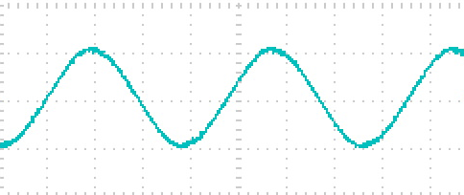
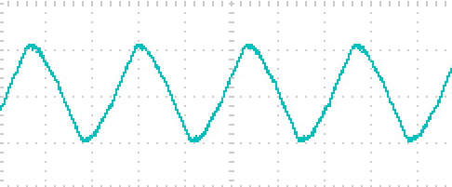
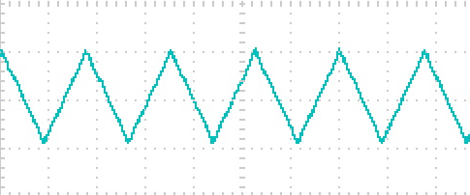
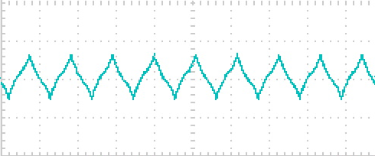
Amplitude vs. Speed Example
Real world example
(actual oscilloscope traces)
Slow…
Faster…
Faster…
Faster…

Slide 22
Fast Microstepping
Inductance can cause microsteps to degenerate into “full steps” at high speeds

Slide 23
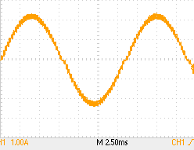
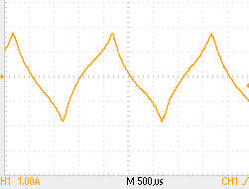
Fast Microstepping
Inductance can cause microsteps to degenerate into “full steps” at high speeds
Real world example
(actual oscilloscope traces)
Slow
Fast

Slide 24
Torque vs. Speed - Back EMF
Turning motor acts as generator
  Generated voltage (back EMF) is opposite polarity of applied voltage
    Effective voltage equals applied voltage minus generated voltage (superposition principle)
  As motor speed increases, generated voltage (back EMF) increases
    As motor speed increases, effective voltage decreases
  As effective voltage decreases, current in motor decreases (rises more slowly)
    As current decreases, torque decreases
Ideal step
Actual current
Slow…
Current rises slower due to back EMF
Faster…

Slide 25
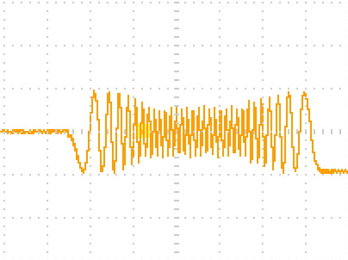
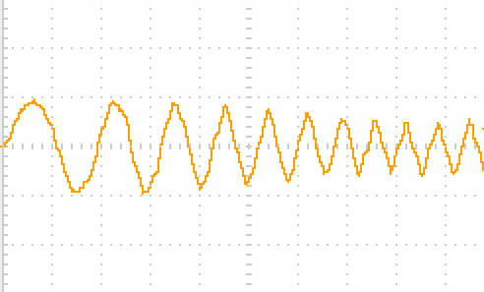
Amplitude vs. Speed Example
Real world example
(actual oscilloscope traces)
Acceleration / Deceleration
Acceleration (Expanded)

Slide 26
Mechanical Resonance
Stepper motors have a natural mechanical resonant frequency
  Can be seen in ringing as position settles after each step
  Frequency depends on characteristics of motor and load
    Resonant frequency of motor alone is typically around 200 Hz
  If step frequency matches resonance, ringing amplitude is increased
    Reduced torque
    Step loss
    Reversal of direction
Rotor Angular Position
Torque
Speed
Resonance
Step
Step
Step

Slide 27
Stepping with Resonance
A
B

Slide 28
Stepping at Resonant Frequency
A
B

Slide 29
Reducing Mechanical Resonance
Mechanical resonance determined by several factors
  Inertial load
    Add inertial damper to rotor
  Step size
    Use half or microstepping
  Step (excitation) frequency
    Run motor at different speed
    Can often accelerate past resonance speed without problem
  Torque
    Run motor at different (usually lower) current

Slide 30
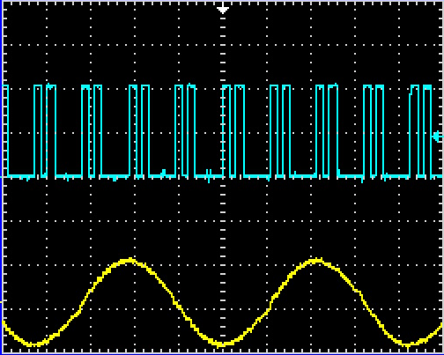
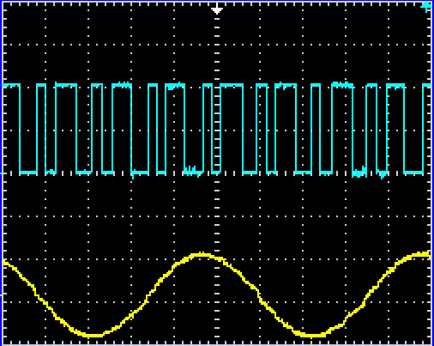
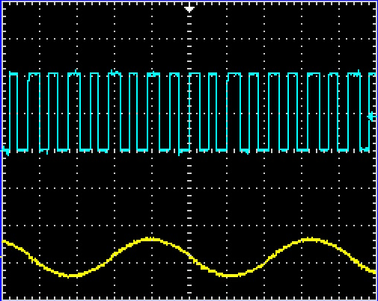
Mechanical Resonance Example
Encoder pulses
(significant resonance)
Real world example
(actual oscilloscope traces)
Current, one coil
Microstepping, 3000 microsteps/sec
2A max
Reduce speed to 2500 microsteps/sec
Reduce current to 1A max
(slight resonance)
(minimal resonance)

Slide 31
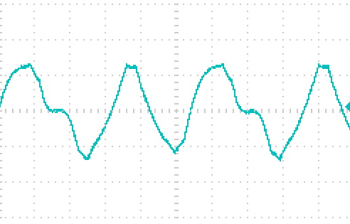
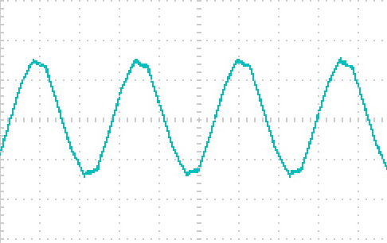
Back EMF and Resonance
Turning motor acts as generator
  If rotor vibrates due to resonance, back EMF also fluctuates
    This causes applied voltage (and current) to fluctuate
    These fluctuations tend to dampen out resonances
    Fluctuations can cause erratic-looking current waveforms on oscilloscope
      Most evident at high speeds (large EMF)
Real world example
(actual oscilloscope traces)
Motor running in resonance
Motor stalled (no back EMF)

Slide 32
Back EMF and No Power
Turning motor acts as generator
  Turning an unpowered motor by hand generates a voltage
    Voltage produced is proportional to speed of rotation
      High speed = high voltage
    Voltage can be high enough to damage connected electronics
When moving unpowered motors in a system, move them
slowly!

Slide 33
Rotor Alignment & Torque
When rotor is aligned with stator, no torque is produced
  Torque is produced only when rotor is misaligned from stator
Aligned:
No torque
Misaligned:
Torque
Torque increases as misalignment increase (up to a point)
  Spring-like effect
Misalignment increases as torque loading increases (position error)
  Position error under load can approach one full step (multiple microsteps)

Slide 34
Torque vs Rotor Displacement
No torque when aligned
Maximum torque at one step displacement
No torque at two steps
(unstable)
Opposite torque
beyond two steps
(max at three)
No torque again at four steps (stable)
- Torque +
Torque vs displacement is approximately sinusoidal
0
1
2
3
4
Displacement (steps)

Slide 35
Lost Steps (Displacement)
If rotor is displaced less than two steps, it will return to next original position (no lost steps)
- Torque +
0
1
2
3
4
5
6
Displacement (steps)

Slide 36
Lost Steps (Displacement)
If rotor is displaced past two steps, it will snap to next detent position (lose four steps)
- Torque +
0
1
2
3
4
5
6
Displacement (steps)

Slide 37
Lost Steps (Torque Load)
If torque load increases past maximum (detent/holding) torque, will lose many steps
- Torque +
0
1
2
3
4
5
6
Displacement (steps)

Slide 38
Detecting Lost Steps
Can monitor rotor position using rotary encoder
  Optical vs magnetic
  Incremental vs absolute position
    Incremental encoder must be “homed” to establish initial position
  Can often be integrated into motor assembly
  Software can restore motor position if cause of error is removed
Some stepper motor drivers include electronic stall detection
  Monitors back EMF during off time between PWM pulses
  Only works at moderate step speeds
    Too slow: EMF too small to measure reliably
    Too fast: off time to short to get reliable measurement
  May not detect steps when motor is holding
  May not reliably indicate number of lost steps

Slide 39
Closing the loop
One advantage of steppers is that they can often be run “open loop” (no position feedback) resulting in lower cost
“Closed loop stepper” often means using position feedback (encoder) to detect lost steps and then adding corrective steps
Can also use servocontrol to reduce current required
  Usually, steppers must add additional torque beyond maximum load to prevent lost steps
  Extra torque can cause resonance, especially under light variable loads
  Also wastes power (heat)
Normally steppers have some position error when under load
  Use servocontrol of motor current to hold error to acceptable level
  Use less current under light loads to reduce heat, resonance issues
Can also use methods such as Field Oriented Control to reduce position error to near zero
  Position stepper to one side of desired position (e.g. 90 degrees) to induce intentional (opposite) error
  Use servocontrol of motor current to control error such that rotor is exactly in desired position (intentional error is equal to load error)

Slide 40
Unipolar vs Bipolar Coils
Unipolar: current flows in one half of center-tapped coil
  Half of coil is not used, therefore less efficient use of copper wire (motor must be larger to develop same torque)
  Autotransformer effects reduce efficiency, etc.
Bipolar: current flows both ways through coil
  Requires more sophisticated switching circuits
V_{BB}
V_{BB}
Unipolar Coil
Bipolar Coil

Slide 41
Unipolar vs Bipolar Coils
Unipolar: current flows in one half of center-tapped coil
  Half of coil is not used, therefore less efficient use of copper wire (motor must be larger to develop same torque)
  Autotransformer effects reduce efficiency, etc.
Bipolar: current flows both ways through coil
  Requires more sophisticated switching circuits
V_{BB}
V_{BB}
Unipolar Coil
Bipolar Coil

Slide 42
Unipolar vs Bipolar Coils
Unipolar: current flows in one half of center-tapped coil
  Half of coil is not used, therefore less efficient use of copper wire (motor must be larger to develop same torque)
  Autotransformer effects reduce efficiency, etc.
Bipolar: current flows both ways through coil
  Requires more sophisticated switching circuits
V_{BB}
V_{BB}
Unipolar Coil
Bipolar Coil

Slide 43
Unipolar vs Bipolar Coils
Unipolar: current flows in one half of center-tapped coil
  Half of coil is not used, therefore less efficient use of copper wire (motor must be larger to develop same torque)
  Autotransformer effects reduce efficiency, etc.
Bipolar: current flows both ways through coil
  Requires more sophisticated switching circuits
V_{BB}
V_{BB}
Unipolar Coil
Bipolar Coil

Slide 44
Unipolar vs Bipolar Coils
Unipolar: current flows in one half of center-tapped coil
  Half of coil is not used, therefore less efficient use of copper wire (motor must be larger to develop same torque)
  Autotransformer effects reduce efficiency, etc.
Bipolar: current flows both ways through coil
  Requires more sophisticated switching circuits
V_{BB}
V_{BB}
Unipolar Coil
Bipolar Coil

Slide 45
Wiring Configurations
Stepper motors can be wired for various coil configurations:
4 wire
(Bipolar)
5 wire
(Unipolar)
6 wire
(Either)
8 wire
(Either)
  Note: To change direction of rotation, reverse wiring of one coil, not both

Slide 46
Wiring Configurations – 8 wire
When using 8 wire motor in bipolar configuration, can be either series or parallel
Series
Parallel
Less current required for given torque
Less inductance, able to switch current faster (faster stepping)

Slide 47
Fast Stepping
Fast stepping requires fast (sharply rising/falling) step pulses
  Recall torque vs. speed issue
To make current change faster in coil, need higher voltage (V = L di/dt)
  Apply higher voltage during initial portion of pulse while current is building up
    Initial voltage can be up to 10x nominal voltage or more
  Reduce voltage during latter portion of pulse to maintain proper current level
Apply maximum voltage
Apply reduced voltage
Desired current
Current:
Voltage:

Slide 48
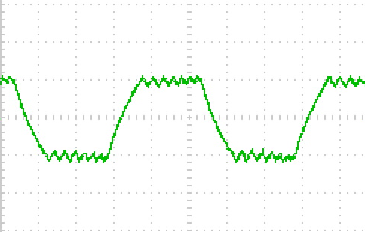
PWM Drive
Producing a variable DC voltage is inefficient
  Excess power is dissipated (wasted) by transistor
  Inefficiency increases as higher voltages are used
Use Pulse Width Modulation (PWM) to control current
  “Chop” drive signal on/off with variable duty cycle to alter average current
  Much better efficiency (same as switching power supply)
Real world example
(actual oscilloscope traces)
Drive Voltage
Average voltage
Average current
Coil Current

Slide 49
PWM Drive for Microstepping
Usually, current limiting circuit is used to adjust PWM
  Pulse width (average voltage) is varied to maintain desired maximum current
PWM is also used to reduce current to coils when microstepping
When PWM is used to do both, pulses can have very short duration
  Pulses can not be shortened beyond a certain minimum (due to blanking time)
  This can lead to distortions in microstep waveform
Two ways to avoid problem
  Use lower microstep resolution (fewer microsteps per step)
  Reduce over-voltage used to drive motor (slower stepping)
Always a tradeoff between microstep resolution and speed

Slide 50
Voltage and Current Ratings
All steppers should specify a maximum current rating
  Exceeding the maximum current will result in overheating
A voltage rating might also be specified
  This is not a maximum value; rather it is the steady-state DC voltage that will create the maximum current (i.e. the “reduced voltage” in earlier slide)
A higher drive voltage can be used if driver is current limited
  This will cause the current to ramp up faster (faster stepping)
  The higher the drive voltage is above rated value, the faster you can step
To step faster, choose a lower voltage motor
  Motor current will increase proportionally
To reduce microstep distortion, choose a higher voltage motor
  Motor current will decrease proportionally

Slide 51
Effects of PWM Frequency
Low PWM frequency
More ripple
  Large ripple can cause rough mechanical motion
High PWM frequency
Less precise control
  Shorter pulses require more exact on/off timing
  Run into problems with minimum pulse width
Higher electrical switching losses
  Power dissipated is proportional to switching frequency
If frequency is in audible range, hum can be produced as coil wires vibrate due to oscillating magnetic field
Typical PWM frequency is around 25kHz

Slide 52
Current Requirements for PWM Drive
When using PWM drive, current into driver circuit is less than current out (through motor)
  Driver acts as a switching power supply, reducing voltage, increasing current
Power (voltage x current) into PWM drive circuit equals power out
  P_{OUT} = (motor current) x (rated motor voltage)
  Since input voltage is greater than output voltage, input current is correspondingly lower than output current.
    If drive voltage is twice nominal motor voltage, then driver input current is half of motor current
Driver input current equals motor power divided by driver voltage
V_{M} x I_{M}
V_{D} x I_{D} = V_{M} x I_{M} → I_{D} =
V_{D}
When in doubt, consult with your friendly EE!

Slide 53
Decay rates
The manner in which current in coil is turned off is significant;
Fast Decay
  Fast transient response, can generate fast, sharp pulses
  Forces current down quickly by “throwing into reverse”
  Able to achieve higher speeds
Slow Decay
  Slow transient response, ramps pulse edges
  Allows current to “coast” down slowly
  Reduces EMI, smoother slow speed stepping
Mixed Decay
  Start with fast decay for a short time, then switch to slow decay
    Fast decay typically 20% – 50% of total off time
  Allows for a moderate decay rate
Some systems change decay modes dynamically
  Fast decay at high speed, slow decay at low speed (when full stepping)
  Slow decay when increasing current, mixed decay when decreasing current (when microstepping)

Slide 54
Decay rates – (Wave Stepping)
Slow decay provides overlap with other pulses, giving smoother transitions between steps and smoother (quieter) operation at slow speed, but can cause problems at higher speed
Slow speed
Slow decay
Fast decay
Fast speed

Slide 55
Decay rates – (Microstepping)
Slow decay creates less ripple in rising edge, giving best rise time. But slow decay on falling edge does not drop fast enough, so fast decay used there.
  Results in greater ripple during falling edge
Fast decay
Unable to decay fast enough on large steps
Slow decay

Slide 56
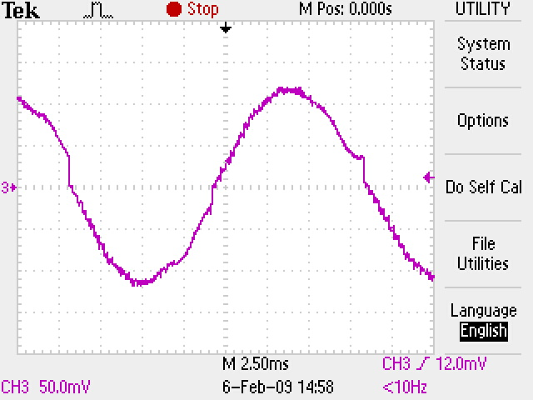
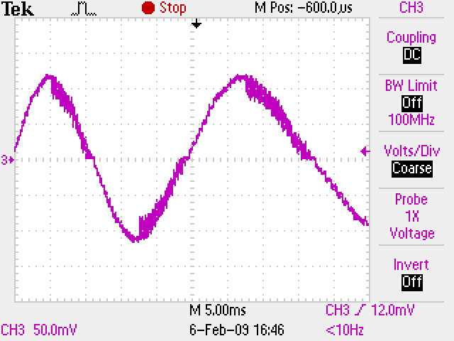
Decay rates – (Microstepping)
Slow decay creates less ripple in rising edge, giving best rise time. But slow decay on falling edge does not drop fast enough, so fast decay used there.
  Results in greater ripple during falling edge
Real world example
(actual oscilloscope traces)
Unable to decay fast enough (Distortion due to min. PWM limit)
Slow decay on both edges
Fast decay (large ripple) on falling edge

Slide 57
Decay rates – (Microstepping)
Mixed decay on the falling edge starts with fast decay to transition to the next step quickly, then changes to slow decay to maintain that level with less ripple.
Mixed decay
Slow decay

Slide 58
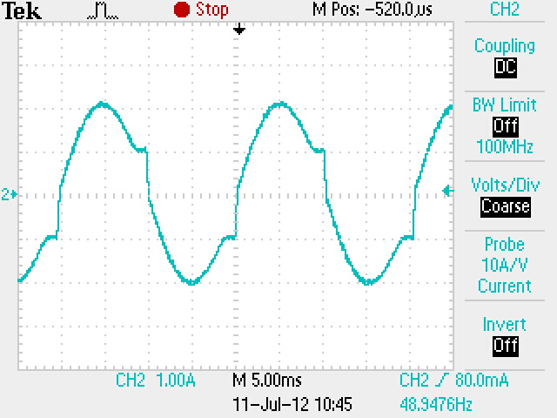
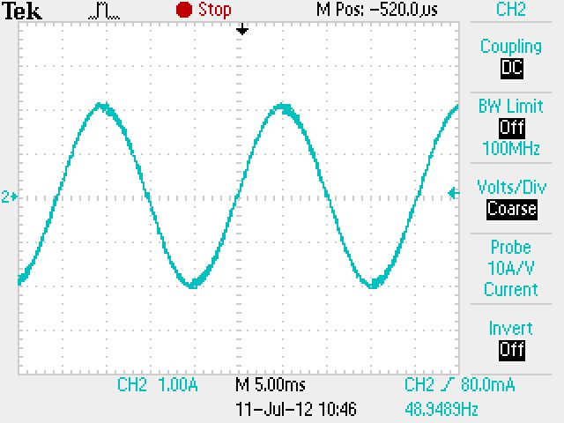
Decay rates – (Microstepping)
Mixed decay on the falling edge starts with fast decay to transition to the next step quickly, then changes to slow decay to maintain that level with less ripple.
Real world example
(actual oscilloscope traces)
Slow decay
Mixed decay (moderate ripple)

